Slide 1
Heather Condon
Pretrial Services Program Manager
Second Judicial District Court
775-325-6610
heather.condon@washoecourts.us
September 22, 2016

Slide 2
Presentation Overview
Pretrial History
Washoe County Pretrial Services Overview
Statistics
Local Changes
Recent
Future

Slide 3
Pretrial History
“Founding Fathers”
Local Movement

Slide 4
Standards & Laws & Research
NRS
NV Constitution
NAPSA
NIC
PJI
Foundations

Slide 5
Washoe County Pretrial Services
Pretrial Goals
2 Teams & 3 Locations
Assessment
Supervision
Community Resources

Slide 6
Supervised Release
Own Recognizance Release
Supervised Bail

Slide 7
Assessment Team Statistics - July
Assessed – 1930
Released – 340
TPOs – 4
PBTs – 620
JC Reinterviews – 25

Slide 8
Supervision Team Statistics - July
Current caseload – 853
In person check-ins – 2637
Drug & Alcohol Testing
PBTs – 1530 / Drug tests – 233
Telephone/email/fax – 1759
Court Reminders – 700
Misc. – 1301
2JDC Reinterviews - 5

Slide 9
Closed Statistics - July
Total – 363
Successful – 284 (78%)
FTA – 30 (8%)
Rearrest – 11 (3%)
Revocation – 38 (10%)

Slide 10
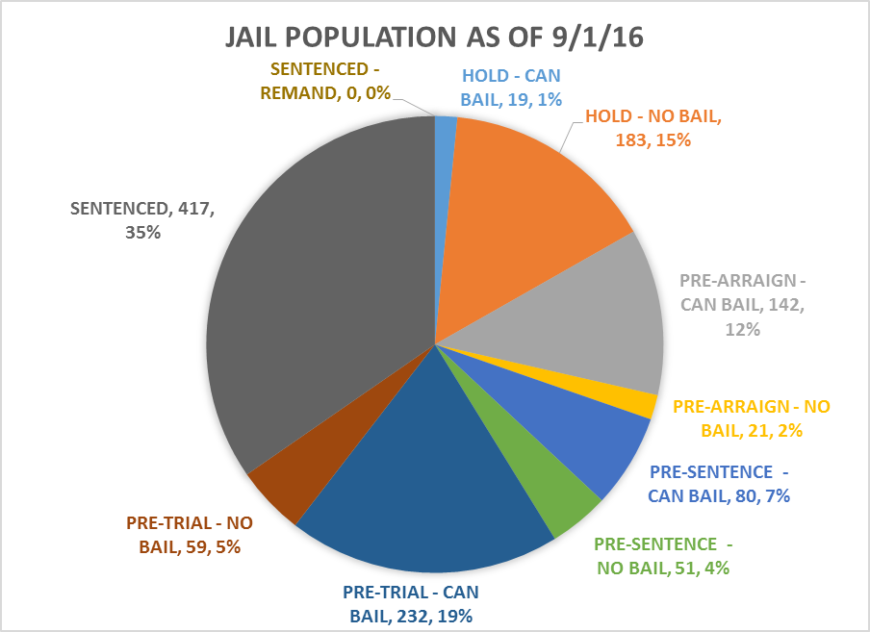

Slide 11
The Second Phase
Judicially imposed bail (release or money)

Slide 12
Recap

